Slide 1


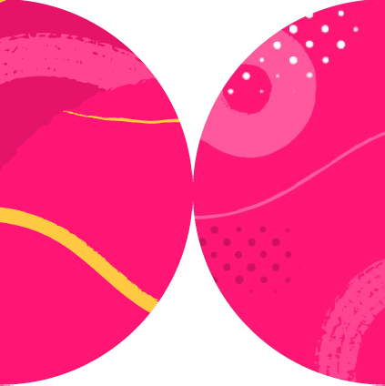

Playwright
Shadow DOM

Slide 2
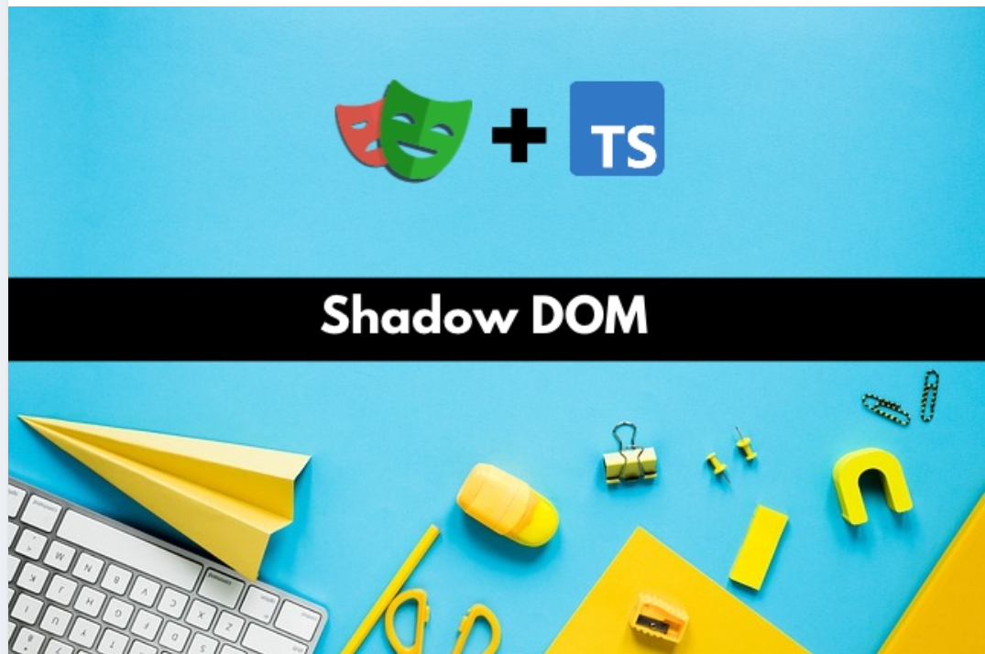

Slide 3

Introduction
Overview
DOM
SHADOW DOM
OPEN AND CLOSED SHADOW DOM
Playwright and the Shadow DOM
Scenarios
Summary
Overview

Slide 4
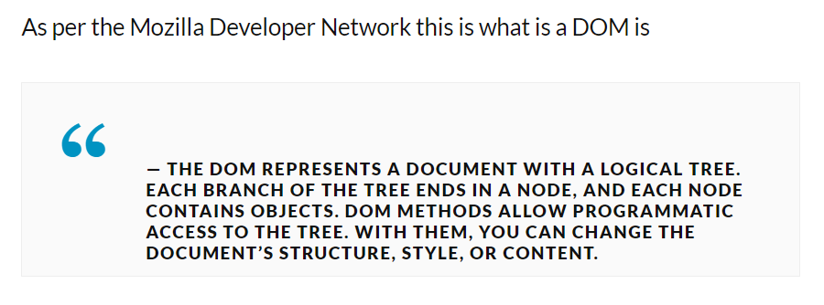

Slide 5
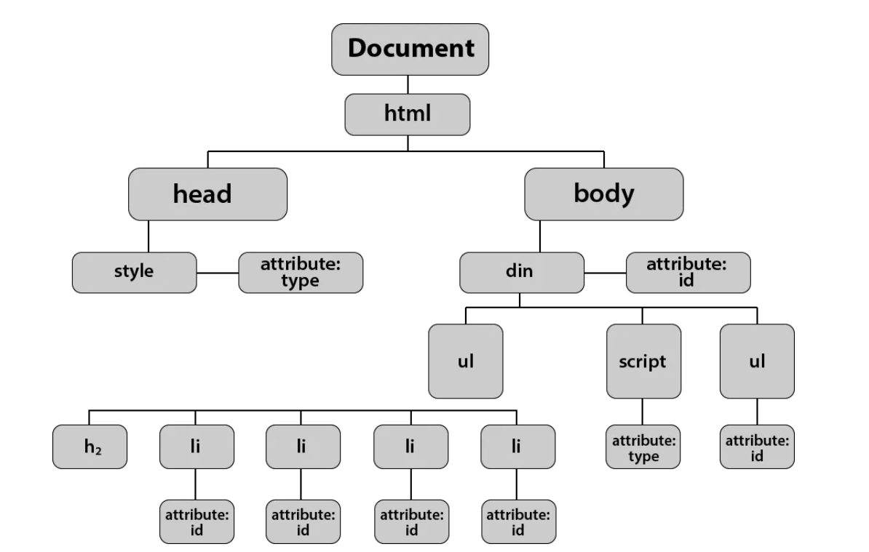

Slide 6
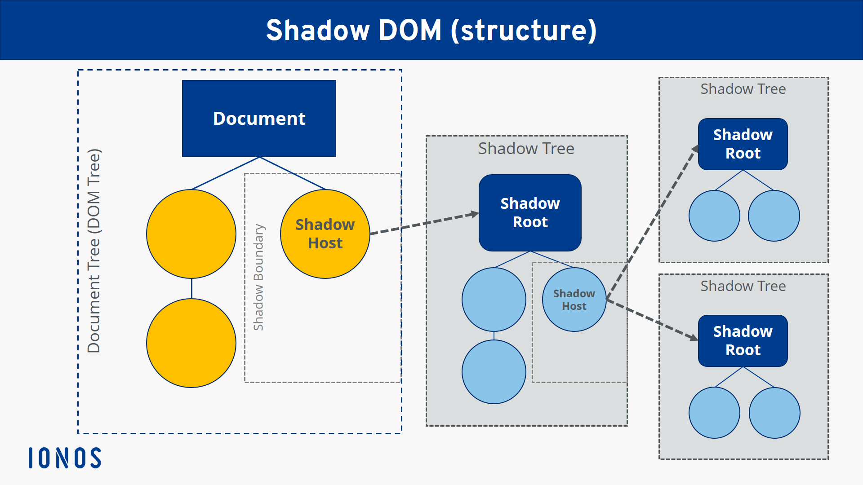

Slide 7
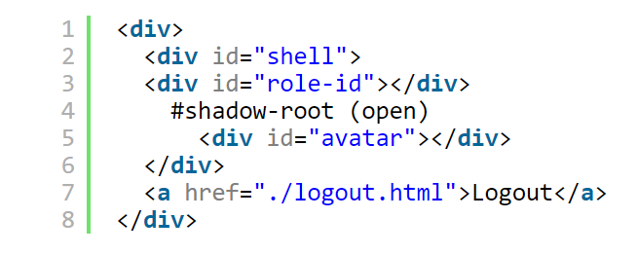

Slide 8
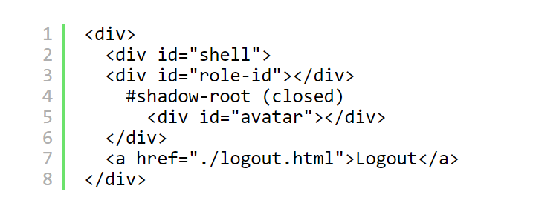

Slide 9
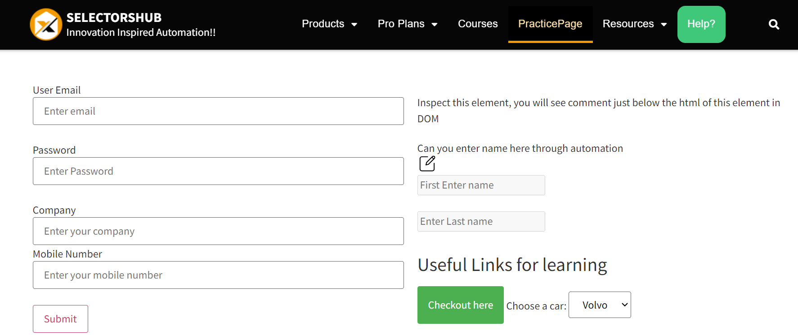

Slide 10
Scenario 1 : Element inside an open Shadow Root
Scenario 2 : Multiple Open Shadow Roots ( Nested Shadow Roots)
Scenario 3 : Element is inside an iframe inside a Shadow Root
Scenario 4 : Element is inside a closed shadow root
Scenario 5 : Element is inside a closed shadow root, which is inside an open shadow root
Shadow Dom Scenarios

Slide 11
Shadow DOM works by allowing you to attach a hidden, separate Document Object Model (DOM) to an element.
This hidden DOM is known as the ‘Shadow DOM’.
The element it’s attached to is referred to as the ‘Shadow Host’.
A Shadow DOM can have additional Shadow Hosts nested under it—this is called a Shadow Tree.
Playwright automatically traverses the Shadow DOM with CSS and text selectors,
Summary

Slide 12
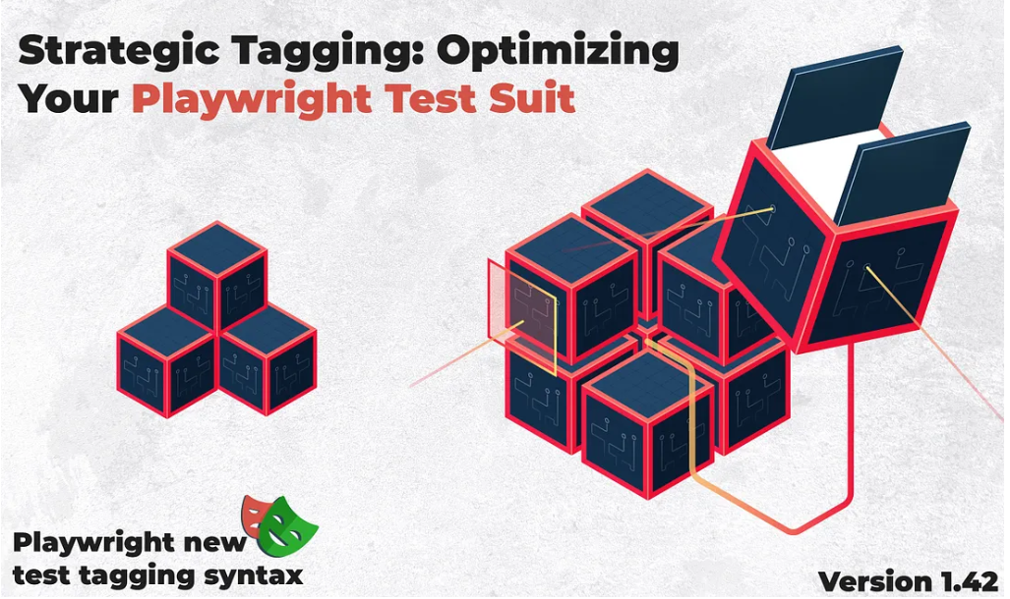

Slide 13
Introduction
Update to the latest version of Playwright
Old Playwright Syntax
How to run tests by tags and using “grep”?
New Playwright Syntax
Advantages of using @tag in test management
Summary
Overview

Slide 14
One or more tags can be attached to a test
Used to organize your test runs
A useful way of filtering your test reports
Each tag is a string.
Playwright automatically tags test results with the browser type (i.e. chromium, firefox, webkit)
Additional tags are up to you
Common ways to use tags:
Browser type (automatic)
Test speed
Area of functionality
Summary

Slide 15


Slide 16
Introduction
Generating screenshots​
Visual Snapshot Comparison in Playwright
Ignore Minor Differences
Image Comparison in Playwright with Threshold option
Playwright Visual Comparison Tips & Tricks
Updating screenshots​
Summary
Overview

Slide 17
Extensive test coverage with minimal effort
Reduce the number of UI test cases
Increase confidence in the quality of changes being made
Summary

